Slide 1

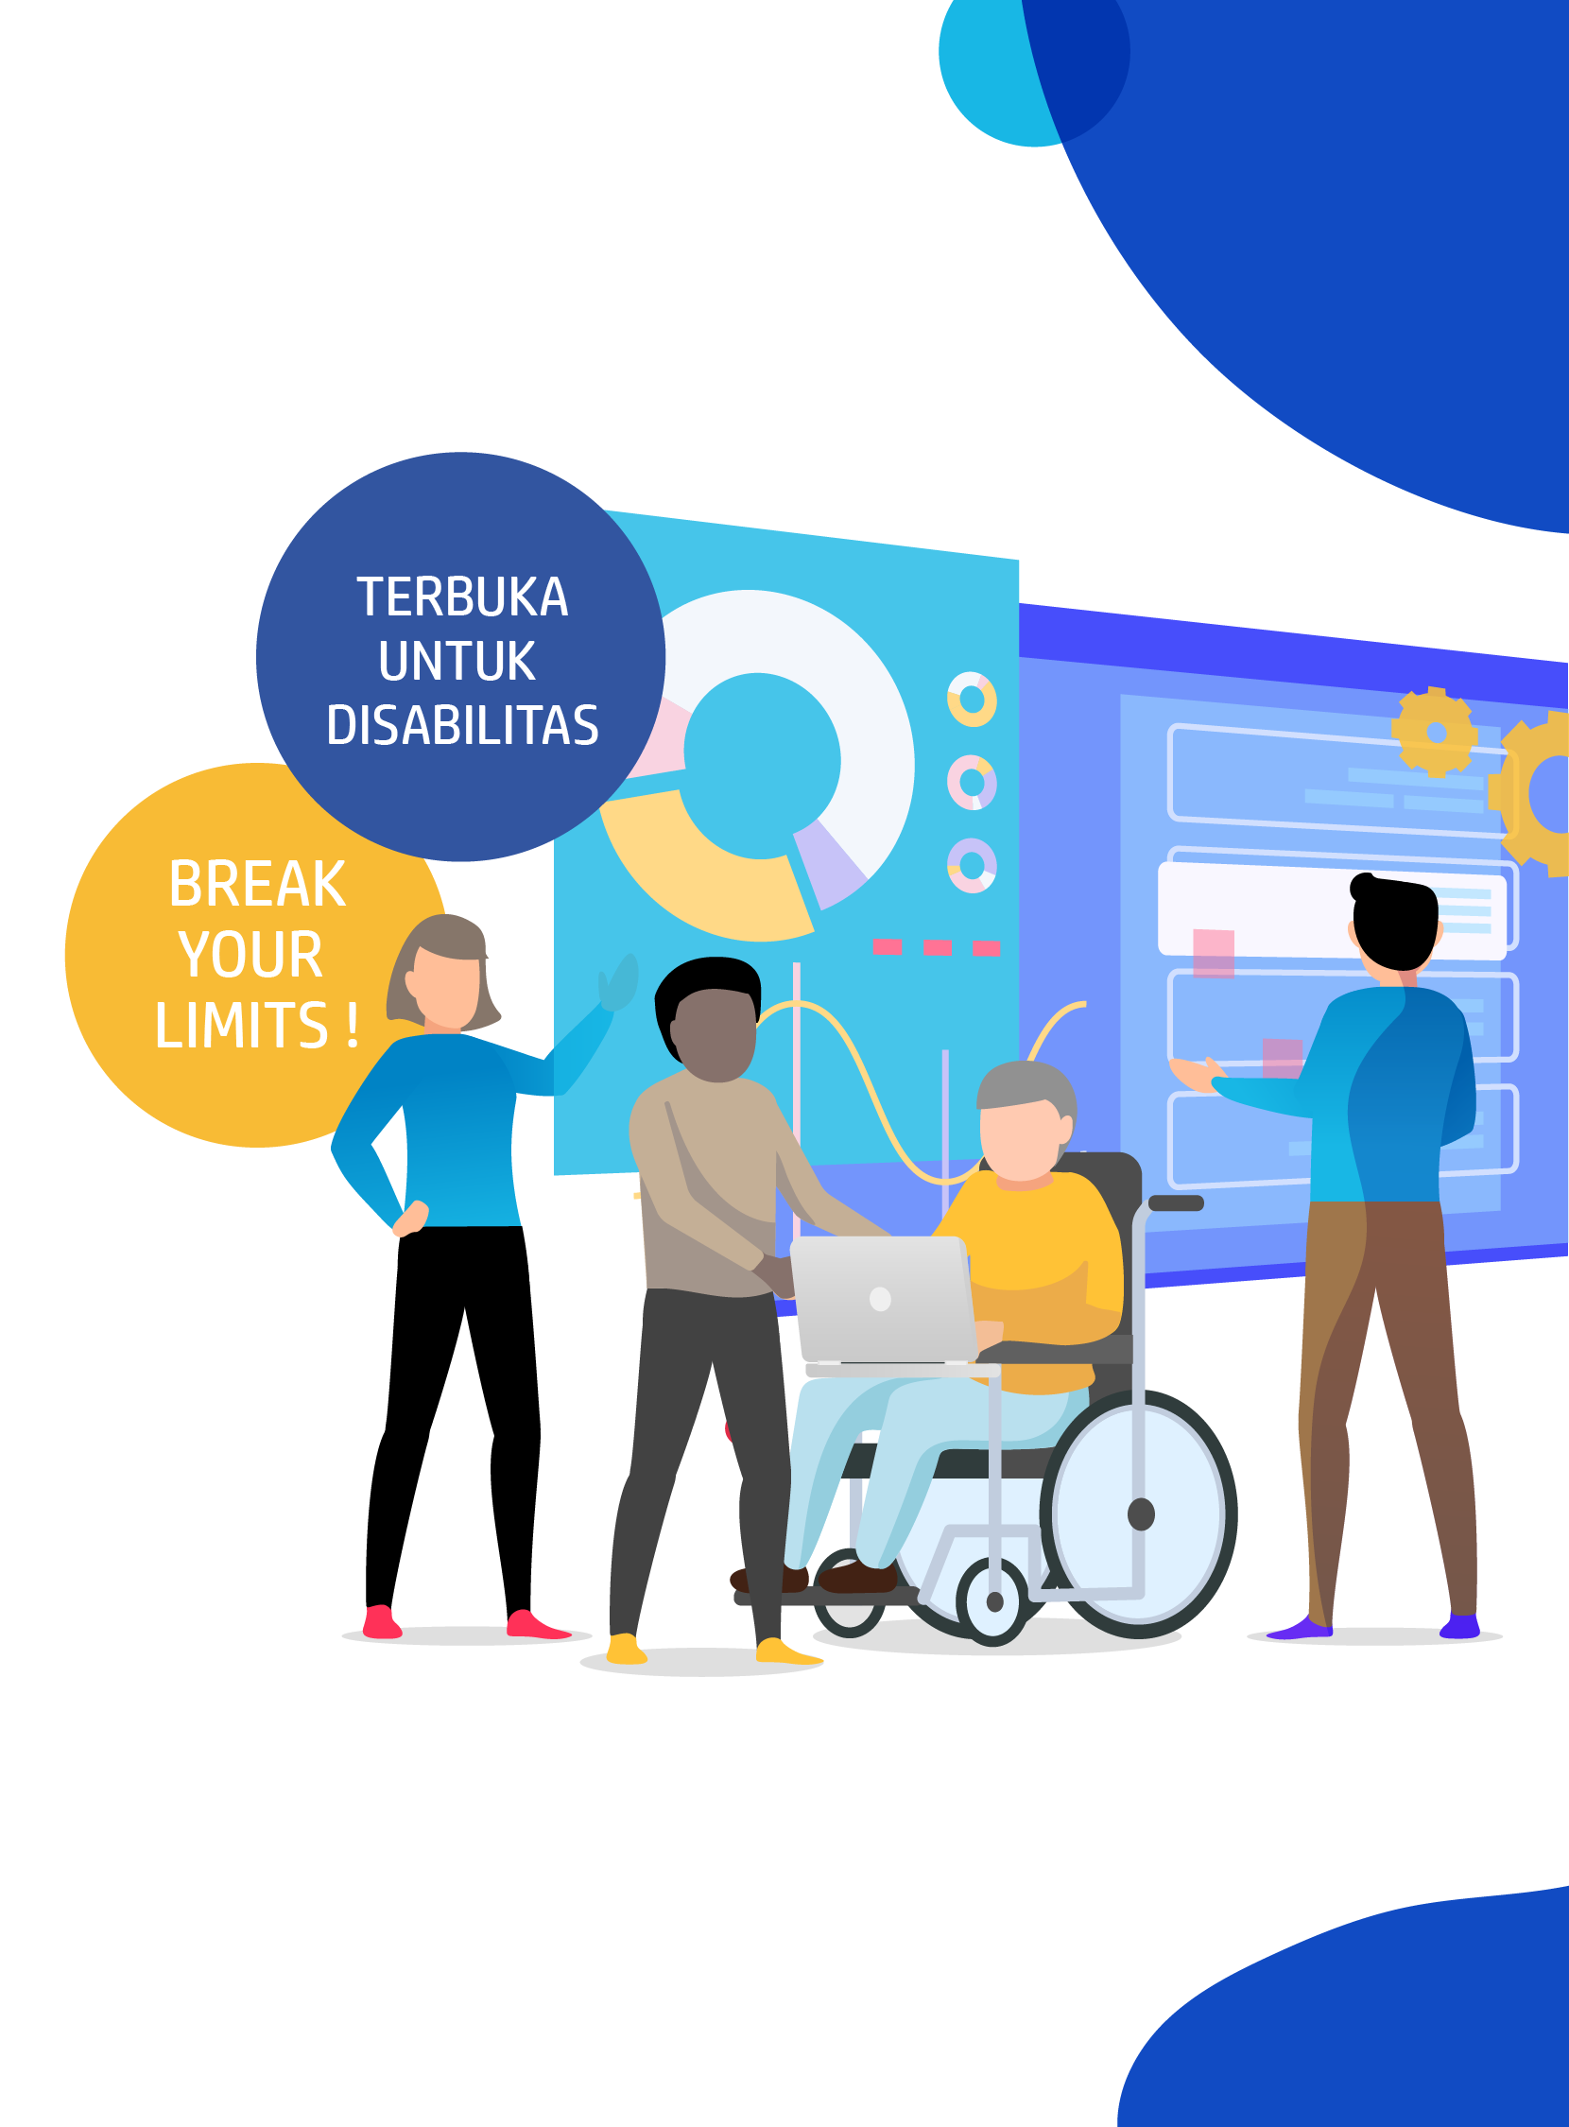




DIGITAL TALENT SCHOLARSHIP
2019
digitalent.kominfo.go.id

Slide 2
Studi Kasus: Colaborative Filtering
Nama pembicara dengan gelar

Slide 3

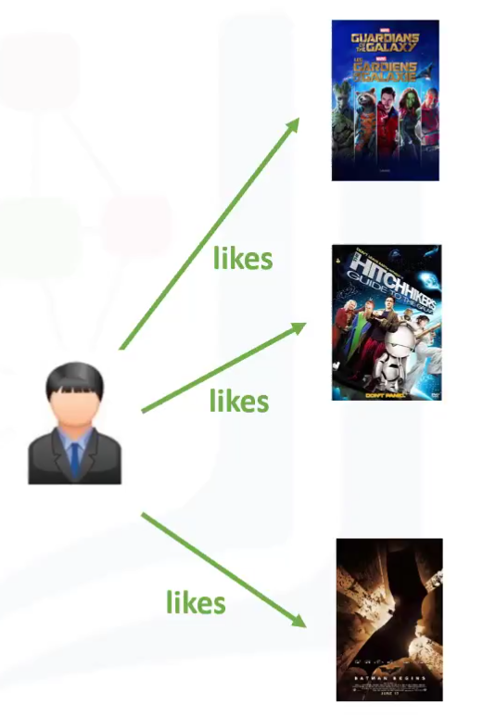
Collaborative Filtering
User-based collaborative filtering
Based on ‘users’ neighborhood
Item-based collaborative filtering
Based on item’s similiarity

Slide 4
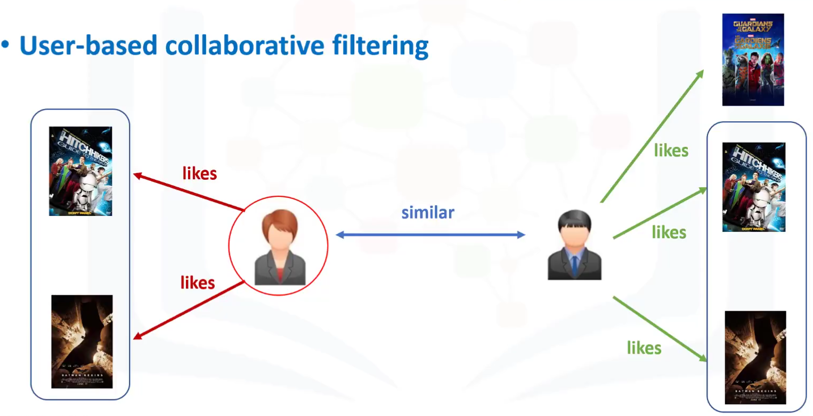
User Based Collaborative Filtering

Slide 5
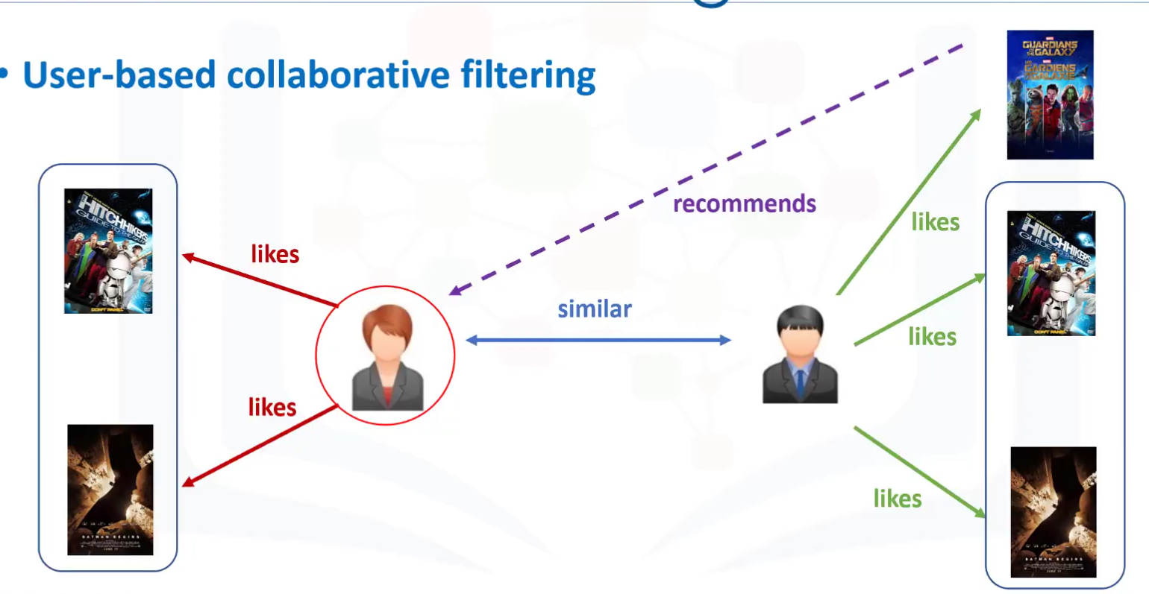
User Based Collaborative Filtering

Slide 6
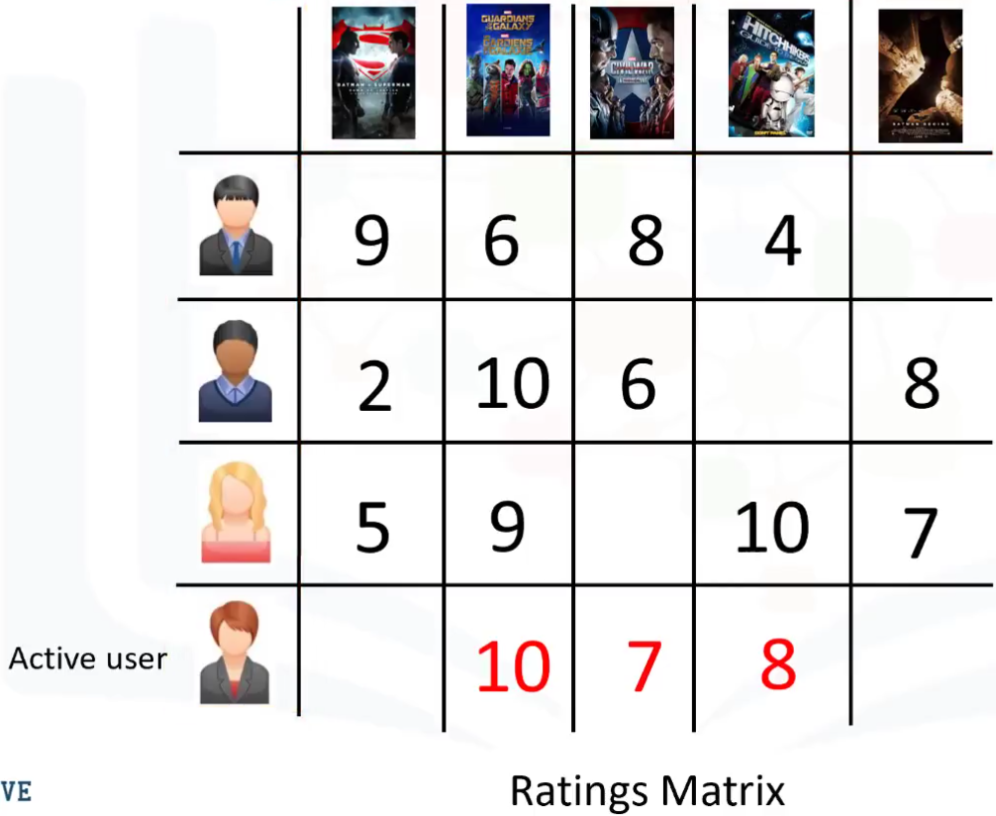
User Rating matrix

Slide 7
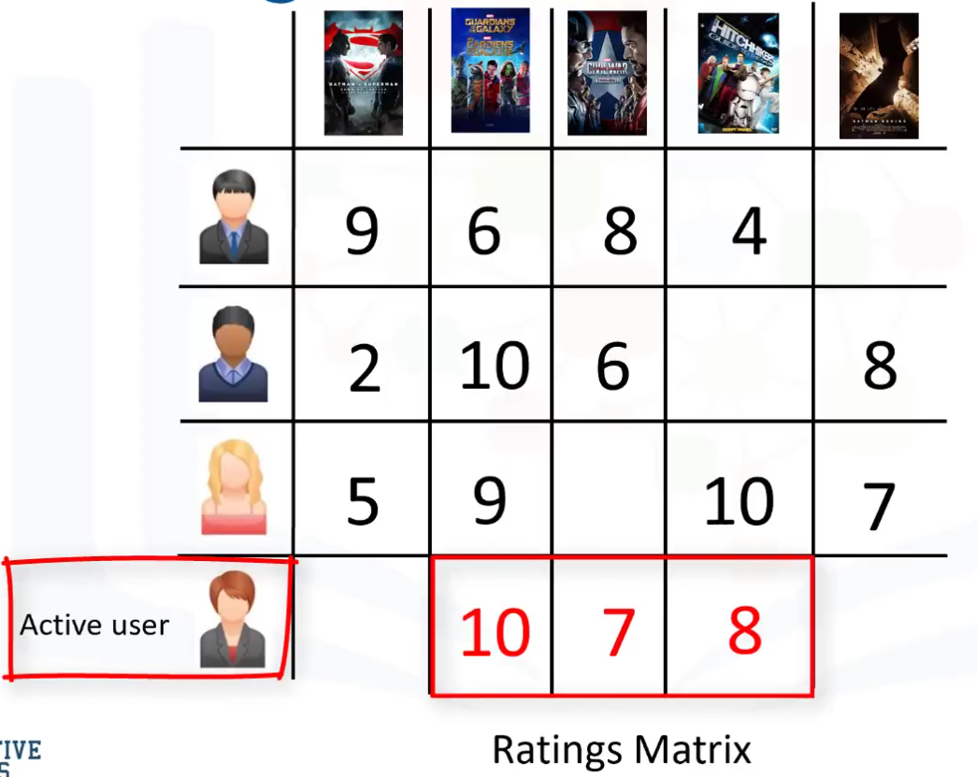
User Rating matrix

Slide 8
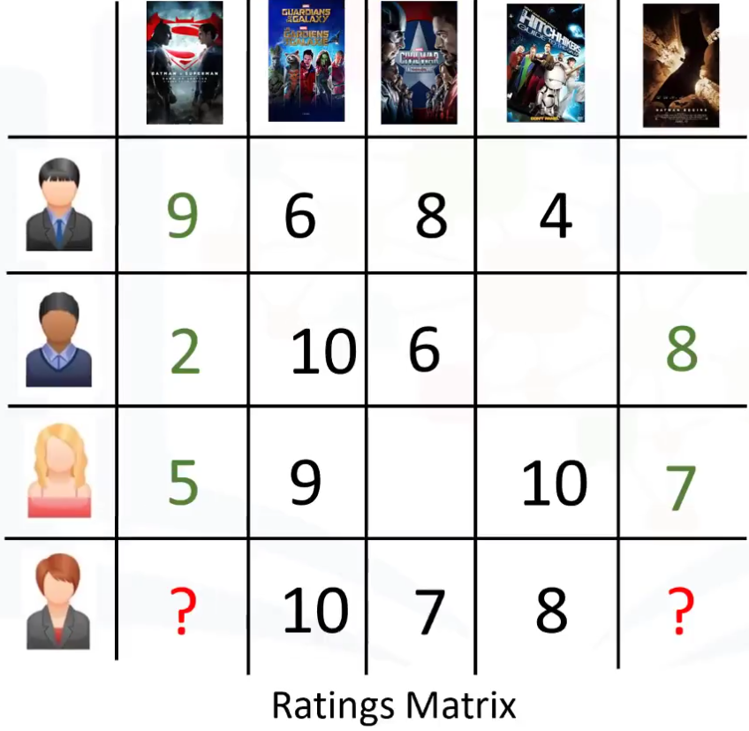
Menentukan Similiarity Weight

Slide 9
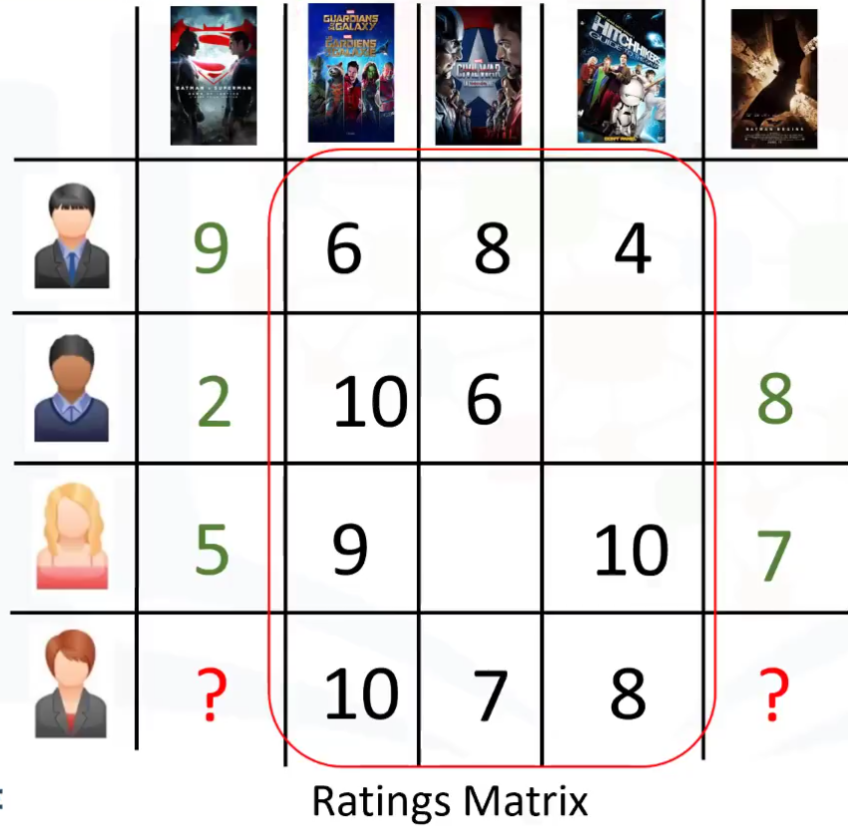
Menentukan Similiarity Weight

Slide 10
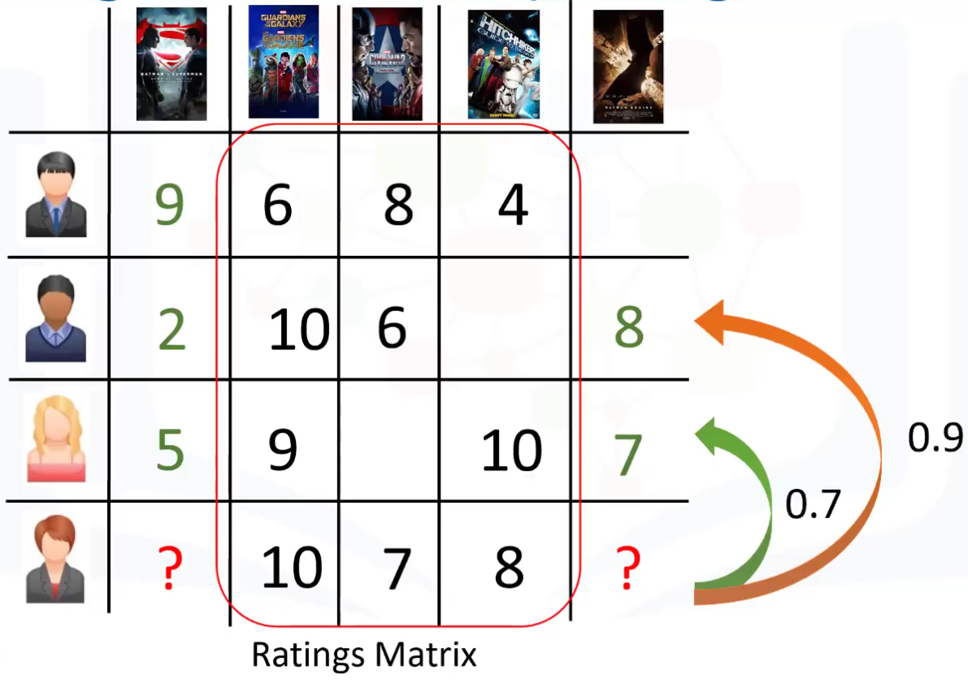
Menentukan Similiarity Weight

Slide 11
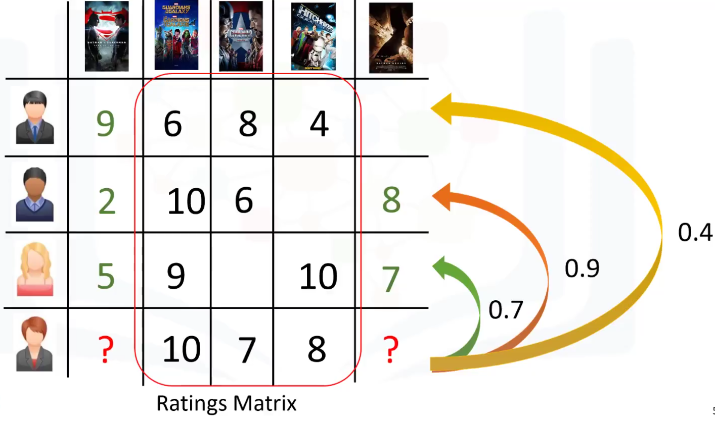
Menentukan Similiarity Weight

Slide 12
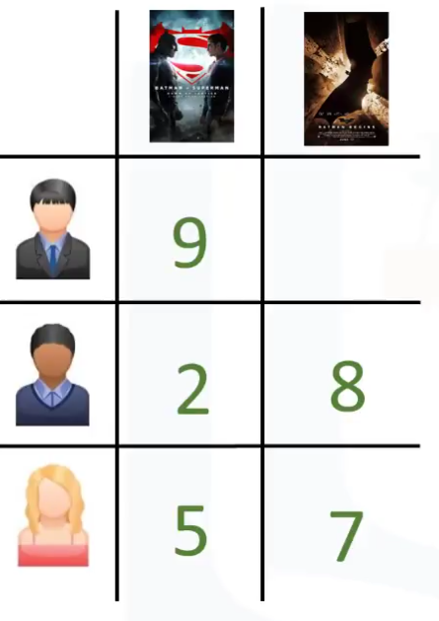
Membuat bobot dari rating matrix

Slide 13
Membuat bobot dari rating matrix

Slide 14
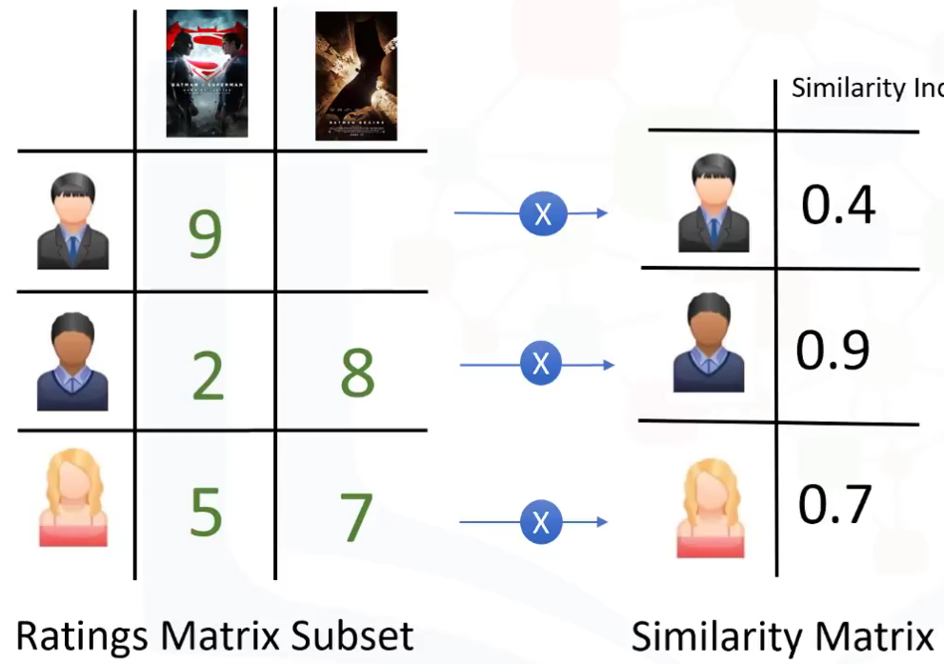
Membuat bobot dari rating matrix

Slide 15
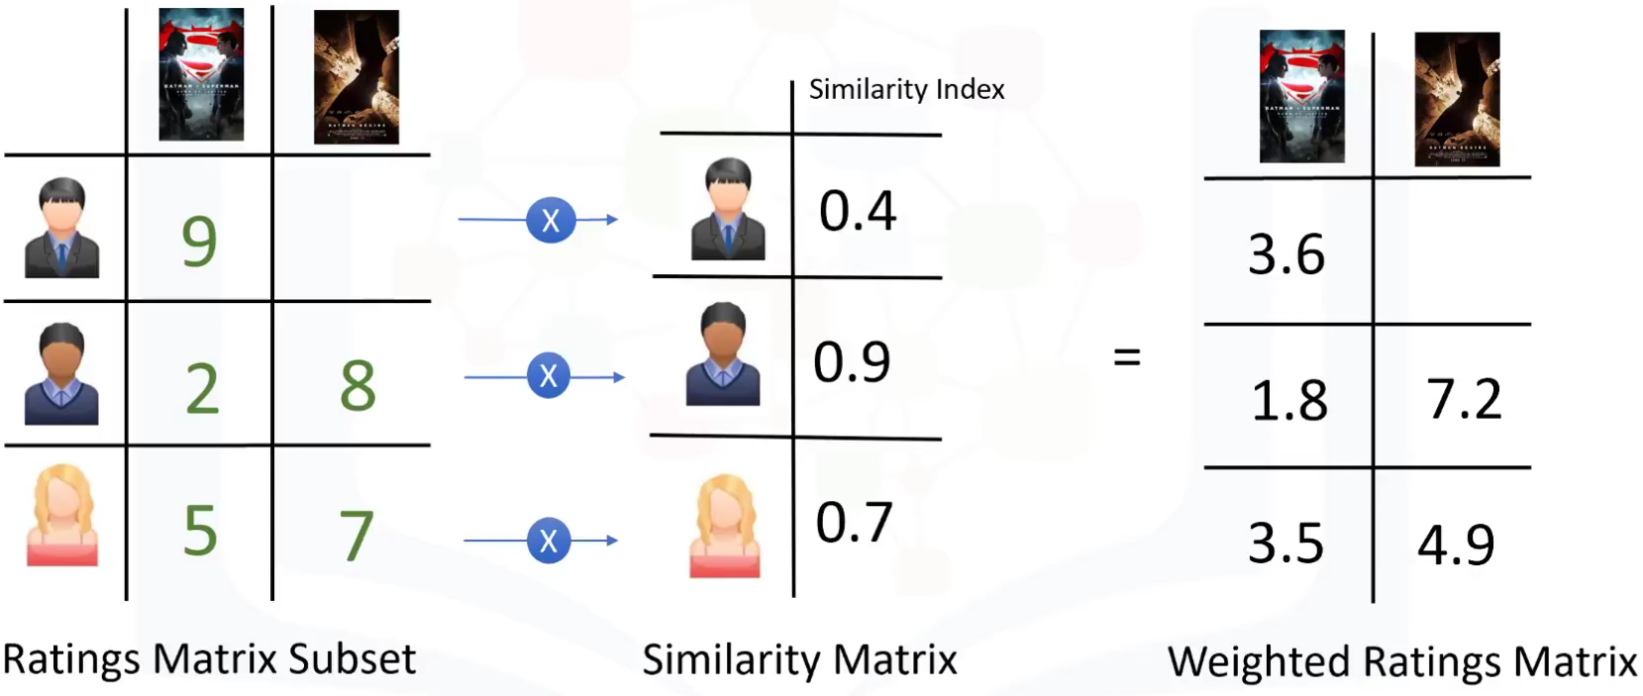
Membuat bobot dari rating matrix

Slide 16
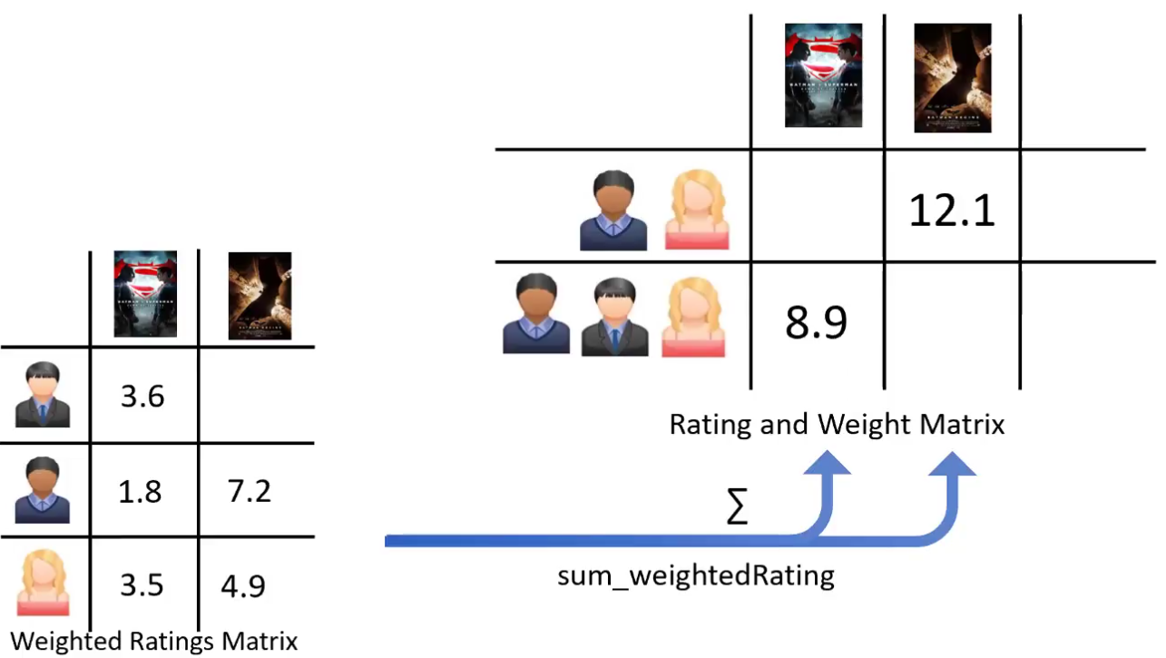

Slide 17
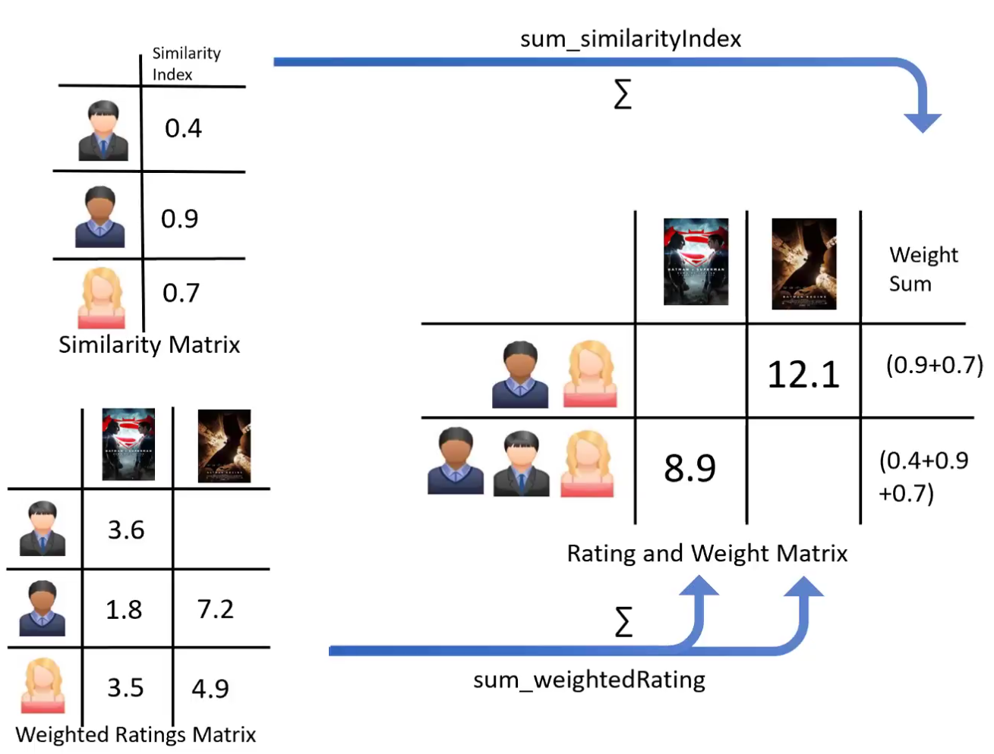

Slide 18
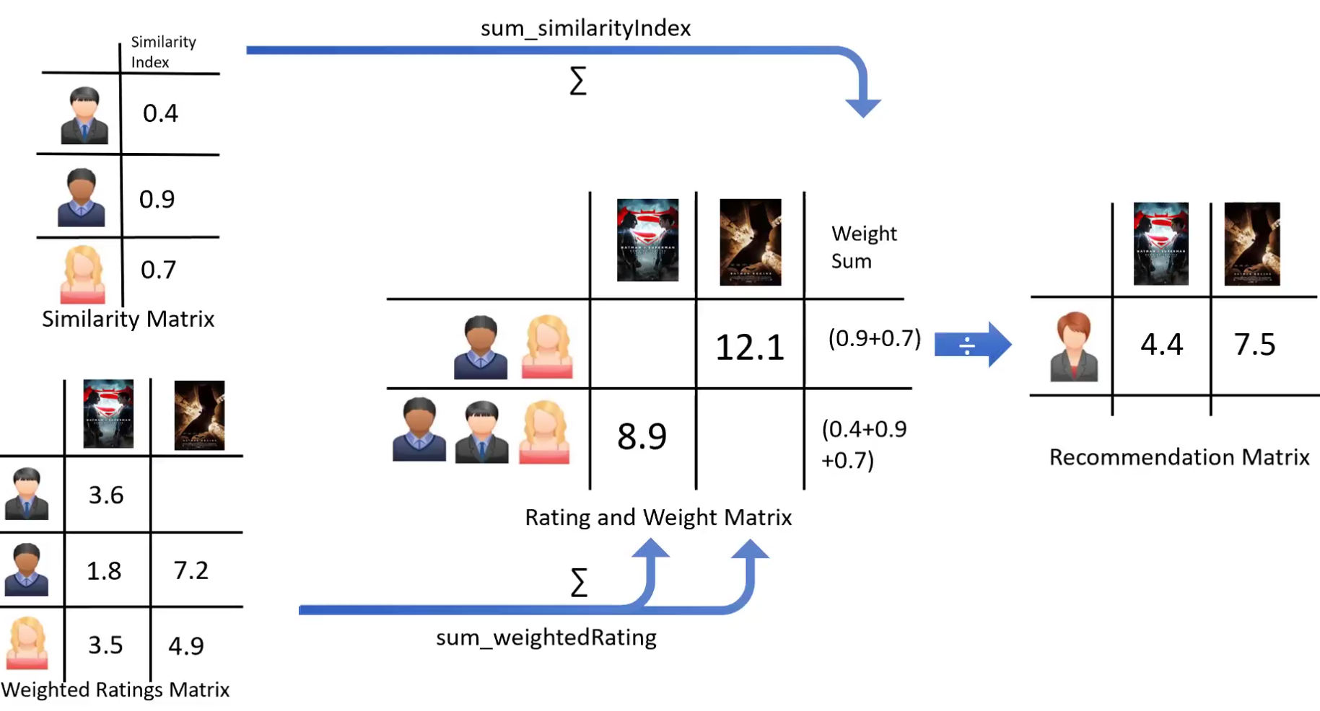

Slide 19
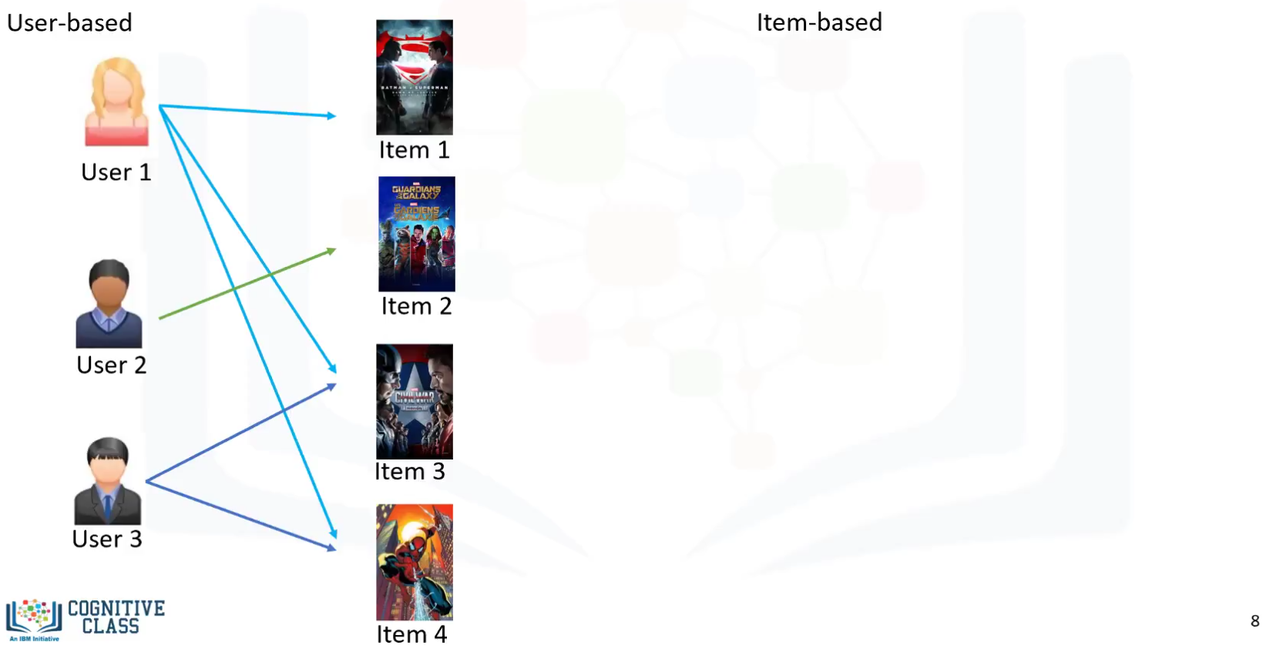
Collaborative Filtering

Slide 20
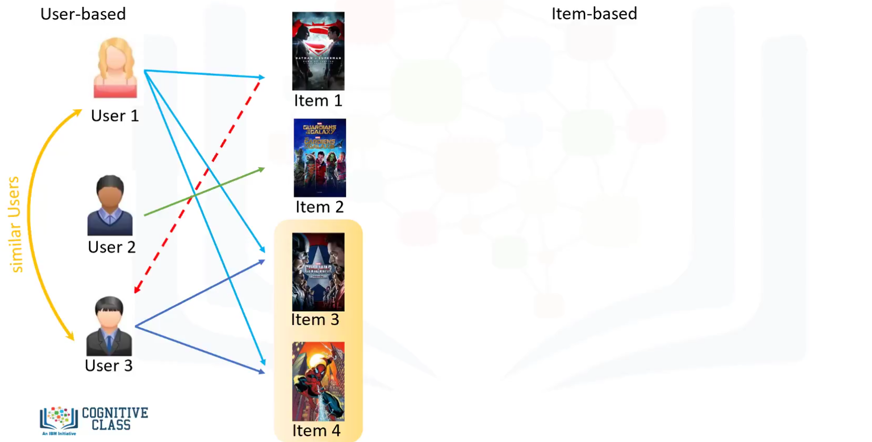
Collaborative Filtering

Slide 21
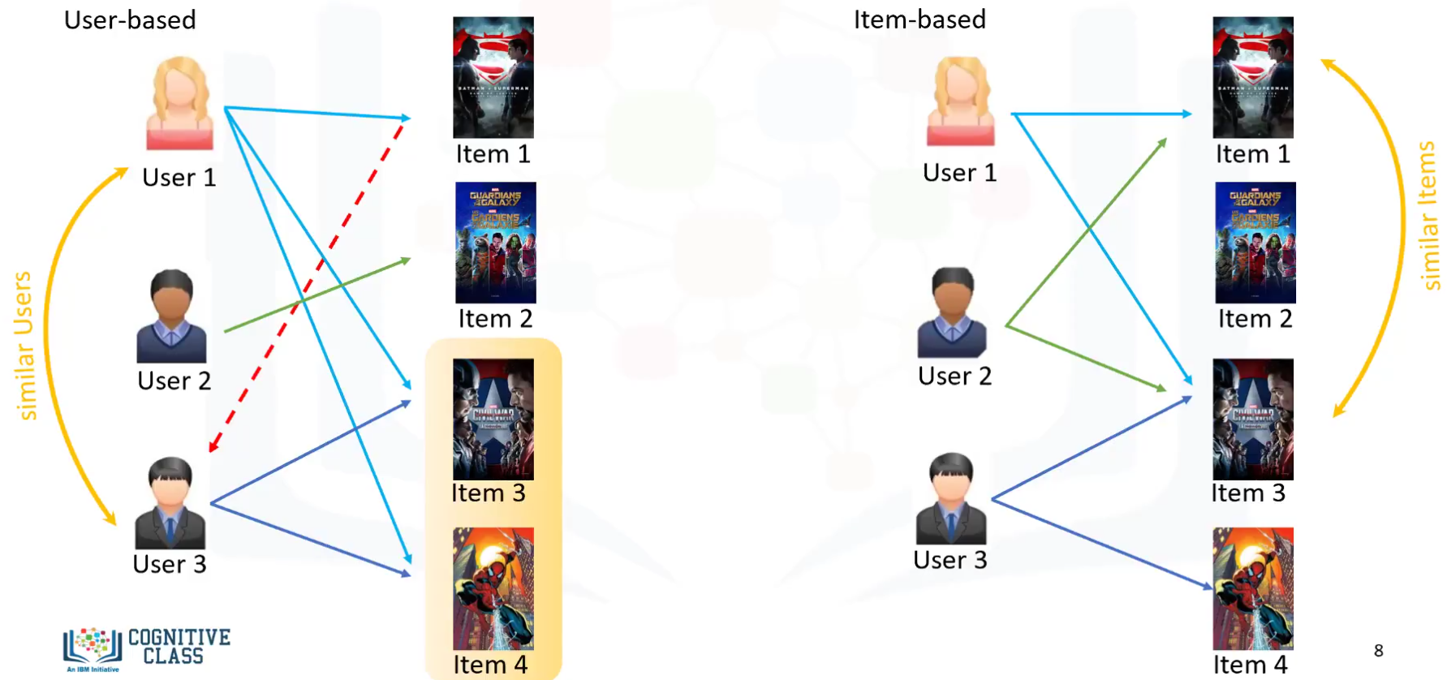

Slide 22
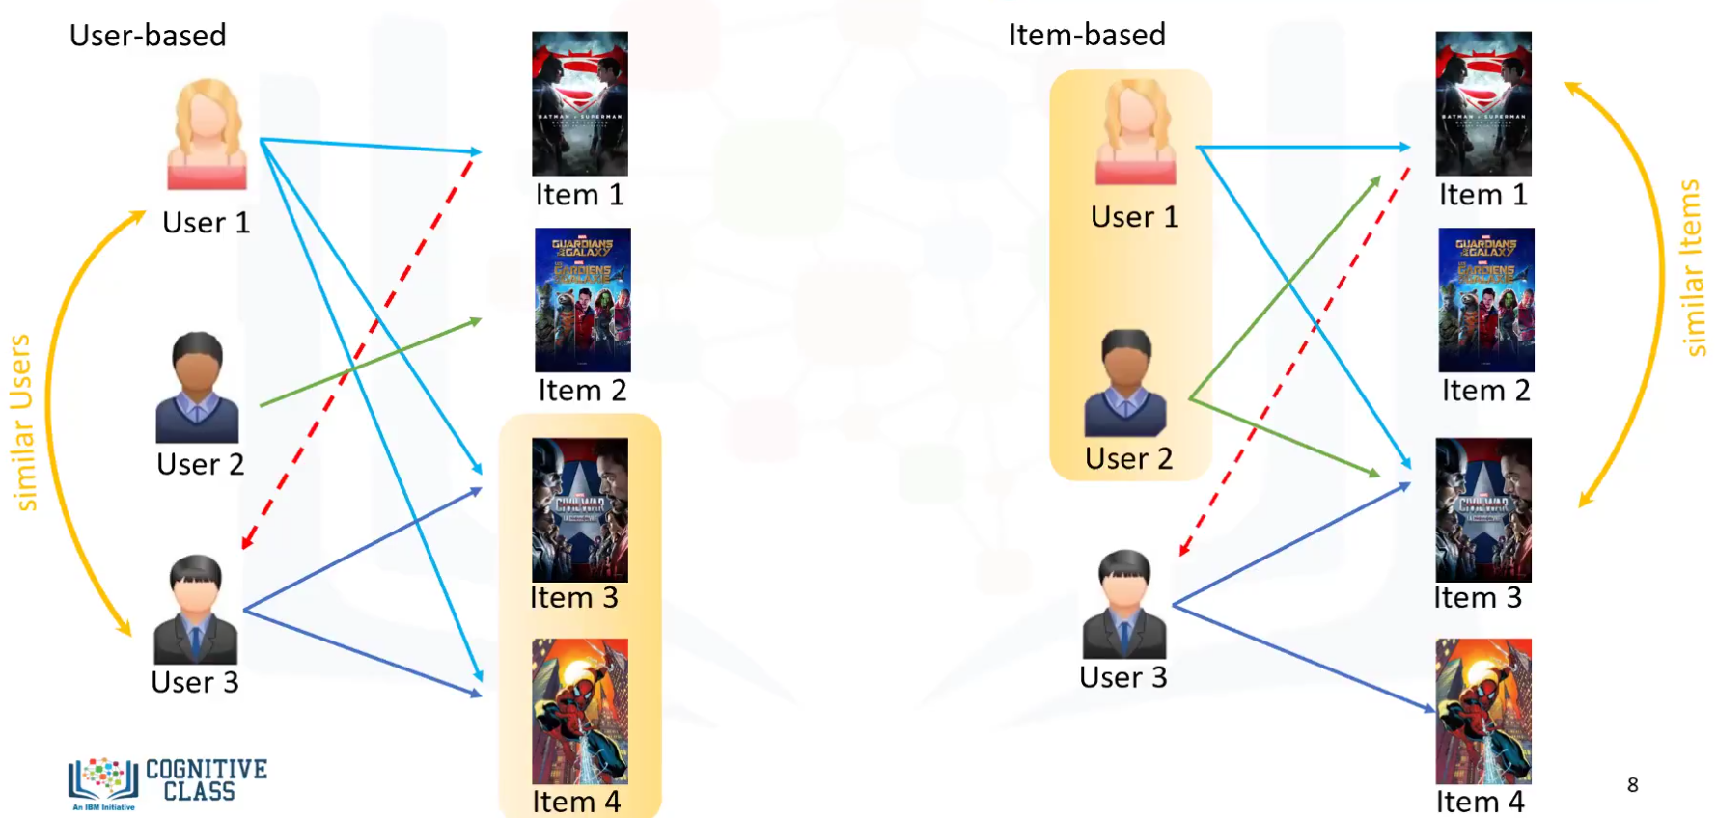

Slide 23
Challenge of Collaborative Learning
Data Sparsity
User in general rate only a limited number of items
Cold Start
Difficulity in recommendation to new users or new items
Scalability
Increase in number of user or items

Slide 24





IKUTI KAMI
digitalent.kominfo
digitalent.kominfo
DTS_kominfo
Digital Talent Scholarship 2019
Pusat Pengembangan Profesi dan Sertifikasi
Badan Penelitian dan Pengembangan SDM
Kementerian Komunikasi dan Informatika
Jl. Medan Merdeka Barat No. 9
(Gd. Belakang Lt. 4 - 5)
Jakarta Pusat, 10110
digitalent.kominfo.go.id

